Slide 1
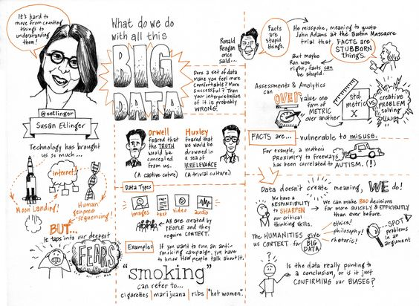
Omeka and Your DH Project
Aspects of Digital Project Design: Building Archives

Slide 2
Basic elements of any DH project
a repository of files or digital assets,
some kind of information architecture or structure,
a suite of services, and
a display for user experience
At their simplest, digital projects can consist of a set files (assets) stored in an information architecture such as a database or file system (structure) where they can be accessed (services) and called by a browser (use/display).

Slide 3
Tool Talk: Omeka
What is it good for?
https://eng392.maristsites.org/

Slide 4
Understanding Omeka
As we learned from Posner’s “Up and Running with Omeka”, Omeka is good for creating digital archives where one can organize and highlight objects in a collection or exhibit.
When to use:
Need to display a set of digital objects on the web
Tell a story of those digital objects (an exhibit)
When not to use:
Create a website/blog (Omeka is meant for exhibits, creating web pages requires extra work/knowledge)
Need advanced data structure, searching, or visualization

Slide 5









Prototype with Omeka
Omeka has many extensions for testing how one’s information is best communicated
What you can prototype with Omeka:
Timelines (Neatline Time)
Maps (Geolocation and Neatline)
Mobile Tours (CurateScape)
Advanced relationships between objects (Item Relations)
prototype
OK?
design
evaluate
done!
re-design
The project design process

Slide 6
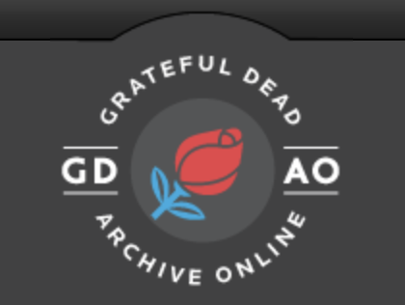
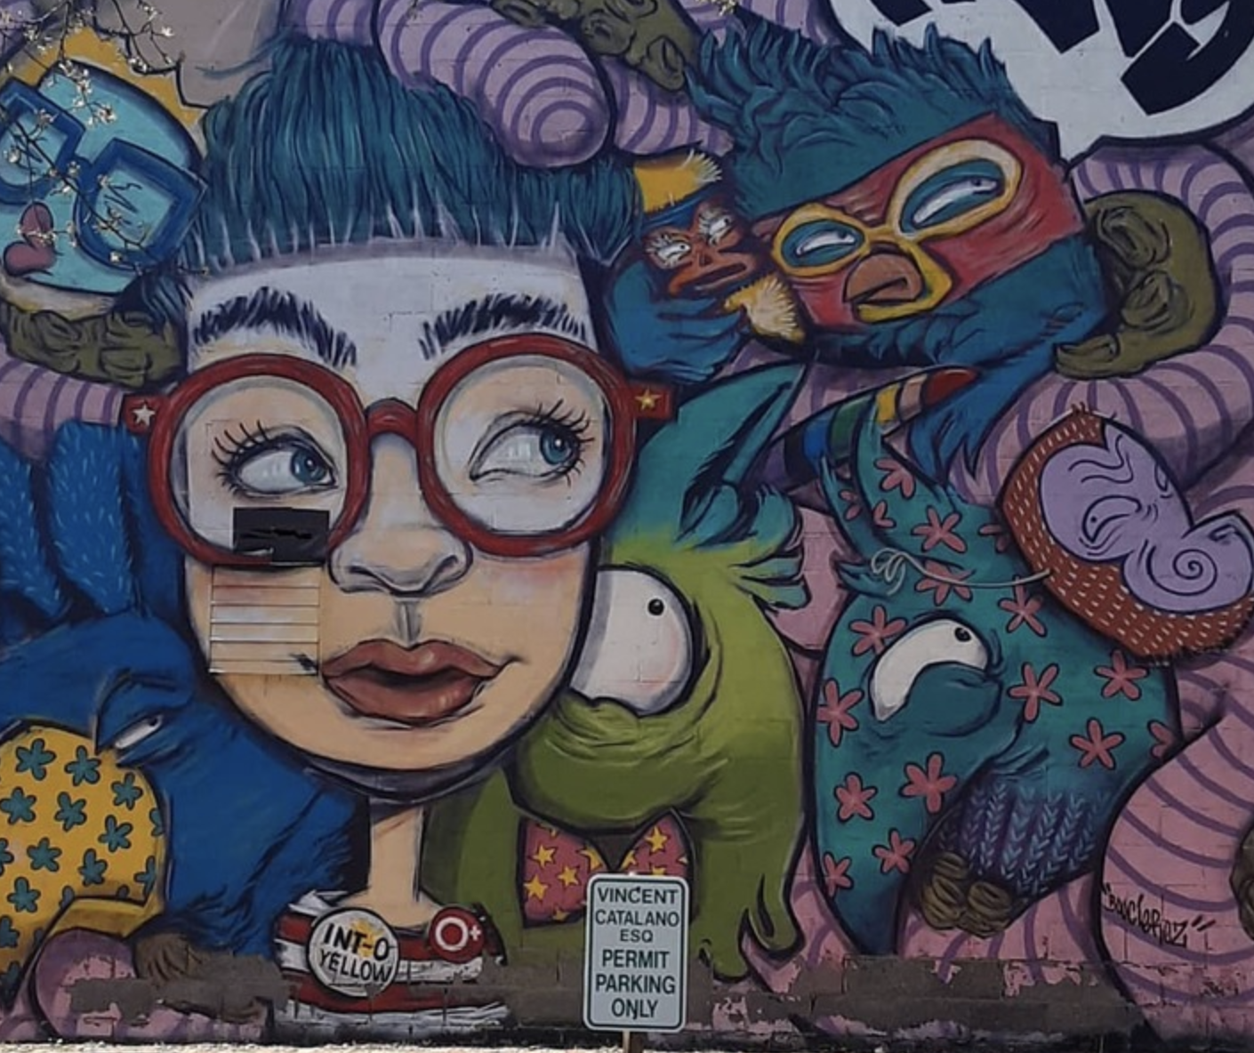
Analyzing Omeka
Group Discussion
Who would be the possible audience(s) for this project?
How would they use the site?
What are the affordances of this site’s functionality and structure? In other words, what does it allow users to do?
What are the constraints of this site’s functionality and structure? In other words, what doesn’t it allow and/or have?
What are the good things about the results you can receive by using this site?
What are the weaknesses or problems with results?
If we were going to continue to develop this project, what would we need to do to build it better?

Slide 7
Developing & Scoping Your Project
What for? = This is #1: Why do this project? What will it contribute, make visible, disrupt, complicate, or problematize? Why is this important to our knowledge, our present moment, our communities, our nation, our world?
Who for? = Who will use this project? What will are the consequences of that use? How have you considered your audience in the project’s design? How have you considered your positionality?
How to build? = What do you envision? How much time and technical support will you need to make this project a reality? How have you considered a scopable prototype?

Slide 8
Your Choices Will Shape the Project
Data Considerations
Where do I get the data and how much do I use?
How much of the project will be digital?
How much of the data to use and what to highlight?
What message to communicate about the data?
How do I want to display the data?
Audience Considerations
Who is the audience?
How will I considered the audience in the design?
Will there likely be more than one audience?
What does audience know about the data?
How will the audience engage with the data?
Building Considerations
Is there a technology that fits project needs “out of the box”?
Is there a technology that can be extended to meet project needs (does it have plugins, etc.)?
Are there resources for functional or design customization?
How much time will I need to learn and deploy the technology?
How transparent and accessible will your data be in any given tool choice?

